Slide 1
Unit 3 Query Languages

Slide 2
Query Languages
Relational Algebra
SQL: DDL, DML, Select Queries, Set, String, Date and Numerical Functions, Aggregate Functions ,Group by and Having Clause
Join Queries, Nested queries
DCL, TCL
PL/SQL: Procedure, Function, Trigger
Mapping of Relational Algebra to SQL

Slide 3
Relational Algebra
The relational algebra provides basic operations which can be performed over single or multiple relations in order to generate new relations(single or multiple).
Relational algebra is a procedural query language which follows a particular syntax with the help of which, data can be accessed and retrieved very easily from single as well as multiple table/data sources.
Certain operators are used to perform queries and retrieve desired results.
These operators can perform certain operations on single attribute(called unary operator) or multiple attribute(called binary operator).
Types of operations in relational algebra
1. Basic Operations
2. Derived Operations

Slide 4
Relational Algebra
Basic/Fundamental Operations:
1. Select (σ)
2. Project (∏)
3. Union (∪)
4. Set Difference (-)
5. Cartesian product (X)
6. Rename (ρ)
Derived Operations:
1. Natural Join (⋈)
2. Left, Right, Full outer join (⟕, ⟖, ⟗)

Slide 5
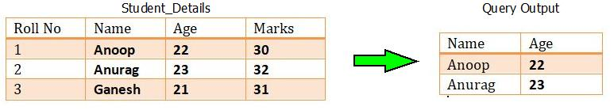
Relational Algebra : Operations
Select (σ): This operation is used to fetch rows from given table or relation on the basis of given conditions, it is denoted by “Sigma(σ)”.
Syntax : σ Condition/Predicate(Relation/Table name)
where clause in SQL, is used for the same purpose.
For example : Consider the table of relation R(Roll No, Name, Age, Marks). If we want to select the name and age of student, then it can be done by:
Query Used : σ Name and Age>21 (Student_Details)

Slide 6
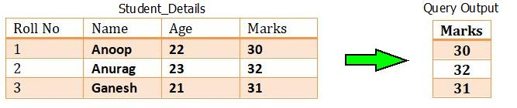
Relational Algebra : Operations
Project(∏): This operation is also used to fetch all the rows/tuples/data according to the requested attribute/Column. It means, using project operation one can simply fetch all the tuples corresponding to a single attribute or multiple attributes. It does not supports any conditions as select operation and is denoted using “Pie(π)”.
Syntax :∏column_name1,column_name2,..,column_nameN(table_name)
Project operator in relational algebra is similar to the Select statement in SQL.
For example : Consider the table of relation R(Roll No, Name, Age, Marks). If we want to project the marks column, then it can be done by :
Query Used : πMarks(Student_Details)

Slide 7
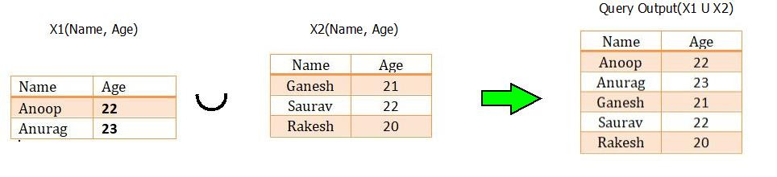
Relational Algebra : Operations
Union(∪):In order to fetch data from two relations to generate new relation with combined capabilities, union operations can be used. The union operation fetches the data from both tables and projects it accordingly. It is denoted through “Union Symbol(U)”.
In Union Operation Both the relations compulsory to have same domain for attributes.
Syntax : X1 U X2 , where X1 & X2 are two different relations satisfying the above two conditions.
Note: The rows (tuples) that are present in both the tables will only appear once in the union set. In short you can say that there are no duplicates present after the union operation.

Slide 8
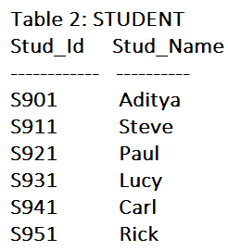
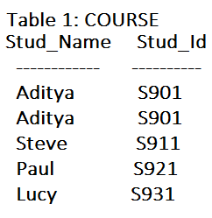
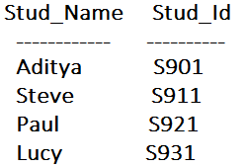

Relational Algebra : Operations
Intersection(∩) : Intersection operator is denoted by ∩ symbol and it is used to select common rows (tuples) from two tables (relations).
Lets say we have two relations R1 and R2 both have same columns and we want to select all those tuples(rows) that are present in both the relations, then in that case we can apply intersection operation on these two relations R1 ∩ R2.
Note: Only those rows that are present in both the tables will appear in the result set. COURSE ∩ STUDENT

Slide 9
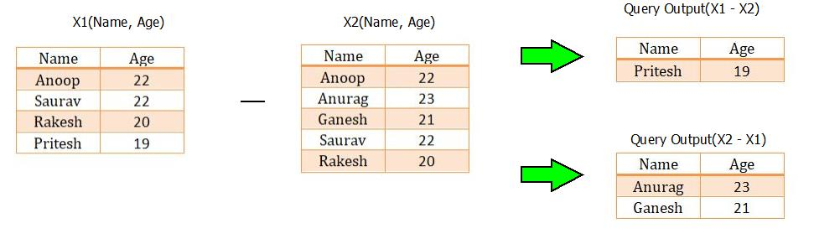
Relational Algebra : Operations
Set Difference (-) : In order to fetch the data which is not present in any one of the relation, set difference operation is used. The set difference operation is denoted by “Minus(-)”.
Lets say we have two relations R1 and R2 and we want to select all those tuples(rows) that are present in Relation R1 but not present in Relation R2, this can be done using Set difference R1 – R2.
For example : Consider the two tables with relations X₁(Name, Age) and X₂(Name, Age). If we wish to apply the set difference operation, then it can be done by :

Slide 10
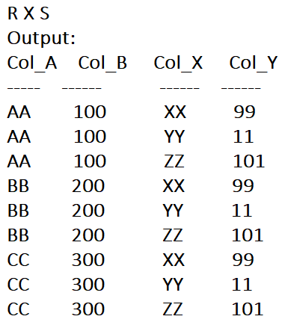
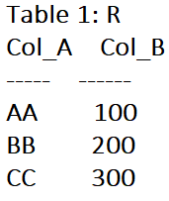
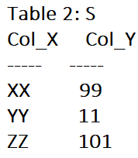
Relational Algebra : Operations
Cartesian product (X): The Cartesian product operation will generate the possible combinations among the tuples from the relations resulting in table containing all the data.
It combines the information of two or more relations in one single relation. Cartesian product is different from union operation and is denoted by “Cross(X)”.

Slide 11
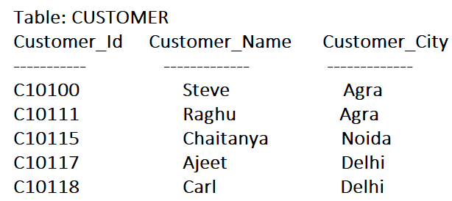
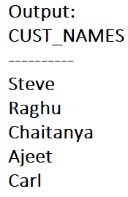
Relational Algebra : Operations
Rename (ρ) : Rename (ρ) operation can be used to rename a relation or an attribute of a relation.
Rename (ρ) Syntax: ρ(new_relation_name, old_relation_name)
Query: ρ(CUST_NAMES, ∏(Customer_Name)(CUSTOMER))

Slide 12
Relational Algebra
Basic/Fundamental Operations:
1. Select (σ)
2. Project (∏)
3. Union (∪)
4. Set Difference (-)
5. Cartesian product (X)
6. Rename (ρ)
Derived Operations:
1. Natural Join (⋈)
2. Left, Right, Full outer join (⟕, ⟖, ⟗)

Slide 13
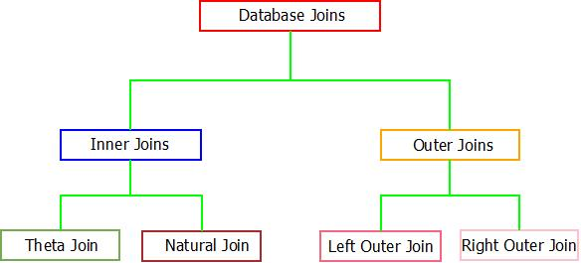
Relational Algebra : Joins
The database joins has the ability of combining two or more data tables/tuples into a single table/table only if the following conditions are satisfied.
There must be a common attribute in both(tables which are participating) tables.
Join condition must be satisfied.
Database joins can be broadly classified into two categories which are further categorized into sub categories.

Slide 14
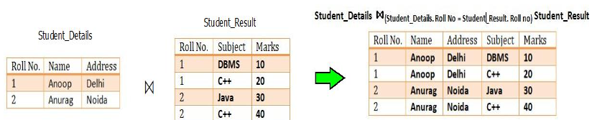
Relational Algebra : Joins (The Inner Joins)
When inner join is applied to tuples or tables, only those tuples of the table are kept which have common attribute in all the tables. Other tuples which are not common are dropped from the resulting tuple/table.
Two possible inner joins are available i.e. Theta Join & Natural Join.
Theta Join :If a condition is satisfied by the participating tables from different relations, then the tuples are combined together using Theta Join. Theta join is denoted through “Theta(Θ)”.
Syntax : R1(X1, X2,X3…Xn) ⋈(Condition “θ”) R2(Y1, Y2,Y3…Yn) where, R1 and R2 are relations having (X1, X2,X3…Xn) and (Y1, Y2,Y3…Yn) as attributes respectively.
For example : Consider the tables Student_Details and Student_Result. Now, if we want to implement theta join on these relations, the result will look like:

Slide 15
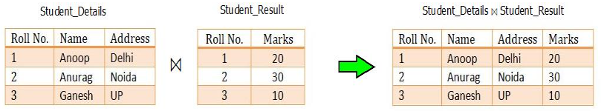
Relational Algebra : Joins (The Inner Joins)
Natural Join (⋈):
Natural join does not supports any condition such as theta join and works only if, one attribute or more than one attributes are common between the joining/participating relations.
Syntax : R1(X1, X2,X3…Xn) ⋈ R2(Y1, Y2,Y3…Yn) where, R1 and R2 are relations having (X1, X2,X3…Xn) and (Y1, Y2,Y3…Yn) as attributes respectively.
For example : Consider the tables Student_Details and Student_Result. Now, if we want to implement natural join on these relations, the result will be

Slide 16
Relational Algebra : Joins (The Outer Joins)
Natural Join (⋈):Outer join overcomes the inability of inner joins of dropping the tuples which are uncommon among participating relations. If we want to display those tuples which are not common, the concept of outer join is used.
Also, if all the tuples needs to be displayed from all the participating relations, outer joins can be used. They are of three types : Left Outer Join, Right Outer Join & Full Outer Join.
Left Outer Join
There exists a concept of position(left or right) of relations in case of both left and right outer join.
In the left outer join, operation allows keeping all tuple in the left relation.
If in case any tuple in left relation does not matches with the tuple in right relation, NULL value will be displayed against that tuple in the resulting relation.

Slide 17

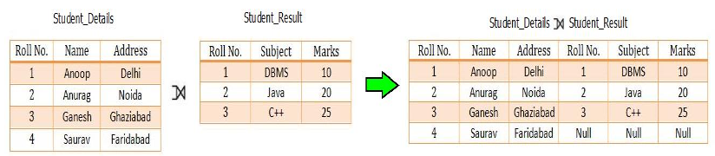
Relational Algebra : Joins (The Outer Joins)
Left Outer Join:
For example : Consider the tables Student_Details and Student_Result. Now, if we want to implement left outer join on these relations, the result will look like:

Slide 18
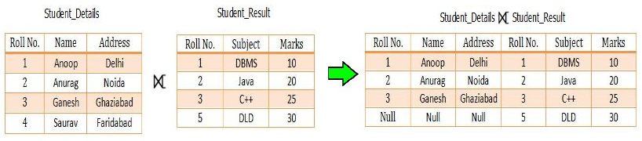
Relational Algebra : Joins (The Outer Joins)
Right Outer Join : In the right outer join, operation allows keeping all tuple in the right relation.
However, if there is no matching tuple is found in the left relation, then the attributes of the left relation in the join result are filled with null values.
For example : Consider the tables Student_Details and Student_Result. Now, if we want to implement right outer join on these relations, the result will look like:

Slide 19
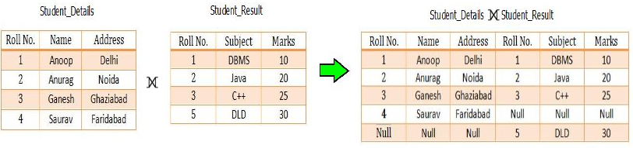
Relational Algebra : Joins (The Outer Joins)
Full Outer Join : In a full outer join, all tuples from both relations are included in the result, irrespective of the matching condition.
If in case, tuples doesn’t matches, NULL value is passes against that.
For example : Consider the tables Student_Details and Student_Result. Now, if we want to implement full outer join on these relations, the result will look like:

Slide 20
Relational Algebra:Summary
Operation (Symbols) | Purpose
Select(σ) | The SELECT operation is used for selecting a subset of the tuples according to a given selection condition
Projection(π) | The projection eliminates all attributes of the input relation but those mentioned in the projection list.
Union Operation(∪) | UNION is symbolized by symbol. It includes all tuples that are in tables A or in B.
Set Difference(-) | The result of A – B, is a relation which includes all tuples that are in A but not in B.
Intersection(∩) | Intersection defines a relation consisting of a set of all tuple that are in both A and B.
Cartesian Product(X) | Cartesian operation is helpful to merge columns from two relations.
Inner Join | Inner join, includes only those tuples that satisfy the matching criteria.
Theta Join(θ) | The general case of JOIN operation is called a Theta join. It is denoted by symbol θ.
EQUI Join | When a theta join uses only equivalence condition, it becomes a equi join.
Natural Join(⋈) | Natural join can only be performed if there is a common attribute between the relations.
Outer Join | In an outer join, along with tuples that satisfy the matching criteria.
Left Outer Join( ) | In the left outer join, operation allows keeping all tuple in the left relation.
Right Outer join( ) | In the right outer join, operation allows keeping all tuple in the right relation.
Full Outer Join( ) | In a full outer join, all tuples from both relations are included in the result irrespective of the matching condition.

Slide 21
What is SQL?
SQL stands for Structured Query Language. It is used for storing and managing data in relational database management system (RDMS).
It is a standard language for Relational Database System. It enables a user to create, read, update and delete relational databases and tables.
All the RDBMS like MySQL, Informix, Oracle, MS Access and SQL Server use SQL as their standard database language.
SQL allows users to query the database in a number of ways, using English-like statements.

Slide 22
SQL Datatype
SQL Datatype is used to define the values that a column can contain.
Every column is required to have a name and data type in the database table.
Data type | Description
char | It has a maximum length of 8000 characters. It contains Fixed-length non-unicode characters.
varchar | It has a maximum length of 8000 characters. It contains variable-length non-unicode characters.
text | It has a maximum length of 2,147,483,647 characters. It contains variable-length non-unicode characters.
Datatype | Description
date | It is used to store the year, month, and days value.
time | It is used to store the hour, minute, and second values.
timestamp | It stores the year, month, day, hour, minute, and the second value.

Slide 23
SQL Datatype
Data type | Description
int | It is used to specify an integer value.
smallint | It is used to specify small integer value.
bit | It has the number of bits to store.
decimal | It specifies a numeric value that can have a decimal number.
numeric | It is used to specify a numeric value.

Slide 24
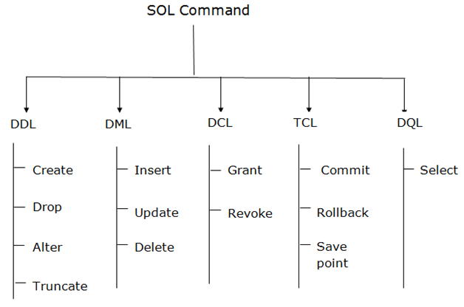
SQL Commands
SQL commands are instructions. It is used to communicate with the database. It is also used to perform specific tasks, functions, and queries of data.
SQL can perform various tasks like create a table, add data to tables, drop the table, modify the table, set permission for users.

Slide 25
SQL Commands
Comments in SQL
Single-Line Comments
The single line comment starts with two hyphens (–). So, any text mentioned after (–), till the end of a single line will be ignored by the compiler.
Example:
--Select all:
SELECT * FROM Employee_Info;
Multi-Line Comments
The Multi-line comments start with /* and end with */. So, any text mentioned between /* and */ will be ignored by the compiler.
Example:
/*Select all the columns
of all the records
from the Employee_Info table:*/
SELECT * FROM Students;
Data Definition Language(DDL) – Consists of commands which are used to define the database.
Data Manipulation Language(DML) – Consists of commands which are used to manipulate the data present in the database.
Data Control Language(DCL) – Consists of commands which deal with the user permissions and controls of the database system.
Transaction Control Language(TCL) – Consist of commands which deal with the transaction of the database.

Slide 26
Data Definition Language (DDL)
DDL changes the structure of the table like creating a table, deleting a table, altering a table, etc.
All the command of DDL are auto-committed that means it permanently save all the changes in the database.
Here are some commands that come under DDL:
CREATE
ALTER
DROP
TRUNCATE
TRUNCATE: It is used to delete all the rows from the table and free the space containing the table.
TRUNCATE TABLE table_name;
TRUNCATE TABLE EMPLOYEE;
DROP: It is used to delete both the structure and record stored in the table.
DROP TABLE table_name;
DROP TABLE EMPLOYEE;

Slide 27
Data Definition Language (DDL)
CREATE It is used to create a new table in the database.
CREATE TABLE TABLE_NAME (COLUMN_NAME DATATYPES[,....]);
CREATE TABLE EMPLOYEE(Name VARCHAR2(20), Email VARCHAR2(100), DOB DATE);
You can also create a table using another table.
Syntax:
CREATE TABLE NewTableName AS
SELECT Column1, column2,..., ColumnN
FROM ExistingTableName
WHERE ....;
Example:
CREATE TABLE ExampleTable AS
SELECT Emp_Name, Phone_Num
FROM Employee_Info;

Slide 28
Data Definition Language (DDL)
ALTER: It is used to alter the structure of the database. This change could be either to modify the characteristics of an existing attribute or probably to add a new attribute.
ALTER TABLE table_name ADD column_name COLUMN-definition;
ALTER TABLE table_name MODIFY(column_definitions....);
ALTER TABLE STU_DETAILS ADD(ADDRESS VARCHAR2(20));
ALTER TABLE STU_DETAILS MODIFY (NAME VARCHAR2(20));
SQL Commands: Constraints Used In Database
Constraints are used in a database to specify the rules for data in a table. The following are the different types of constraints:
NOT NULL :This constraint ensures that a column cannot have a NULL value.
UNIQUE: This constraint ensures that all the values in a column are unique.
CHECK: This constraint ensures that all the values in a column satisfy a specific condition.
DEFAULT: This constraint consists of a set of default values for a column when no value is specified.

Slide 29
Data Definition Language (DDL)
--UNIQUE on Create Table
CREATE TABLE Employee_Info
(
EmployeeID int NOT NULL UNIQUE,
EmployeeName varchar(255) NOT NULL,
Emergency ContactName varchar(255),
PhoneNumber int NOT NULL,
Address varchar(255),
City varchar(255),
Country varchar(255)
);
--UNIQUE on ALTER TABLE
ALTER TABLE Employee_Info
ADD UNIQUE (Employee_ID);
--NOT NULL on Create Table
CREATE TABLE Employee_Info
(
EmployeeID int NOT NULL,
EmployeeName varchar(255) NOT NULL,
Emergency ContactName varchar(255),
PhoneNumber int NOT NULL,
Address varchar(255),
City varchar(255),
Country varchar(255)
);
--NOT NULL on ALTER TABLE
ALTER TABLE Employee_Info
MODIFY PhoneNumber int NOT NULL;

Slide 30
Data Definition Language (DDL)
--DEFAULT Constraint on CREATE TABLE
CREATE TABLE Employee_Info
(
EmployeeID int NOT NULL,
EmployeeName varchar(255),
Emergency ContactName varchar(255),
PhoneNumber int,
Address varchar(255),
City varchar(255),
Country varchar(255) DEFAULT 'India'
);
--DEFAULT Constraint on ALTER TABLE
ALTER TABLE Employee_Info
ADD CONSTRAINT defau_Country
DEFAULT 'India' FOR Country;
--CHECK Constraint on CREATE TABLE
CREATE TABLE Employee_Info
(
EmployeeID int NOT NULL,
EmployeeName varchar(255),
Emergency ContactName varchar(255),
PhoneNumber int,
Address varchar(255),
City varchar(255),
Country varchar(255) CHECK (Country=='India')
);
--CHECK Constraint on ALTER TABLE
ALTER TABLE Employee_Info
ADD CHECK (Country=='India');

Slide 31
Data Manipulation Language
DML commands are used to modify the database. It is responsible for all form of changes in the database.
The command of DML is not auto-committed that means it can't permanently save all the changes in the database. They can be rollback.
INSERT
UPDATE
DELETE
SELECT
INSERT: The INSERT statement is a SQL query. It is used to insert data into the row of a table.
INSERT INTO TABLE_NAME (col1, col2, col3,.... col N) VALUES (value1, value2, value3, .... valueN);
INSERT INTO TABLE_NAME VALUES (value1, value2, value3, .... valueN);
INSERT INTO book (Author, Subject) VALUES (“ABC", "DBMS");

Slide 32
Data Manipulation Language
UPDATE: This command is used to update or modify the value of a column in the table.
UPDATE table_name SET [column_name1= value1,...column_nameN = valueN] [WHERE CONDITION]
UPDATE students SET User_Name = ’XYZ' WHERE Student_Id = '3’
DELETE: It is used to remove one or more row from a table.
DELETE FROM table_name [WHERE condition];
DELETE FROM book WHERE Author=“ABC";

Slide 33
Data Manipulation Language
Example:
SELECT EmployeeID, EmployeeName
FROM Employee_Info;
--(*) is used to select all from the table
SELECT * FROM Employee_Info;
-- To select the number of records to return use:
SELECT TOP 3 * FROM Employee_Info;
you can use the following keywords with the SELECT statement:
DISTINCT
ORDER BY
GROUP BY
HAVING Clause
INTO
SELECT
This statement is used to select data from a database and the data returned is stored in a result table, called the result-set.
Syntax
SELECT Column1, Column2, ...ColumN
FROM TableName;
--(*) is used to select all from the table
SELECT * FROM table_name;
-- To select the number of records to return use:
SELECT TOP 3 * FROM TableName;

Slide 34
Data Manipulation Language
Example:
-- Select all employees from the 'Employee_Info' table sorted by EmergencyContactName:
SELECT * FROM Employee_Info
ORDER BY EmergencyContactName;
-- Select all employees from the 'Employee_Info' table sorted by EmergencyContactName in Descending order:
SELECT * FROM Employee_Info
ORDER BY EmergencyContactName DESC;
The ‘SELECT DISTINCT’ Statement
This statement is used to return only different values.
Syntax:SELECT DISTINCT Column1, Column2, ...ColumnN
FROM TableName;
Example SELECT DISTINCT PhoneNumber FROM Employee_Info;
The ‘ORDER BY’ Statement
The ‘ORDER BY’ statement is used to sort the required results in ascending or descending order. The results are sorted in ascending order by default.
Syntax: SELECT Column1, Column2, ...ColumnN
FROM TableName
ORDER BY Column1, Column2, ... ASC|DESC;

Slide 35
Data Manipulation Language
The ‘HAVING’ Clause
The ‘HAVING’ clause is used in SQL because the WHERE keyword cannot be used everywhere.
Syntax :SELECT ColumnName(s)
FROM TableName
WHERE Condition
GROUP BY ColumnName(s)
HAVING Condition
ORDER BY ColumnName(s);
Example
/* To list the number of employees in each city. The employees should be sorted high to low and only those cities must be included who have more than 5 employees:*/
SELECT COUNT(EmployeeID), City
FROM Employee_Info
GROUP BY City
HAVING COUNT(EmployeeID) > 2
ORDER BY COUNT(EmployeeID) DESC;
The ‘GROUP BY’ Statement
This ‘GROUP BY’ statement is used with the aggregate functions to group the result-set by one or more columns.
Syntax :SELECT Column1, Column2,..., ColumnN
FROM TableName
WHERE Condition
GROUP BY ColumnName(s)
ORDER BY ColumnName(s);
Example
-- To list the number of employees from each city.
SELECT COUNT(EmployeeID), City
FROM Employee_Info
GROUP BY City;

Slide 36
Data Manipulation Language
--To select only few columns from Employee
SELECT EmployeeName, PhoneNumber INTO EmployeeContactDetails
FROM Employee;
SELECT * INTO BlrEmployee
FROM Employee
WHERE City = 'Bangalore';
The ‘SELECT INTO’ Statement
The ‘SELECT INTO’ statement is used to copy data from one table to another.
Syntax
SELECT *
INTO NewTable [IN ExternalDB]
FROM OldTable
WHERE Condition;
Example
-- To create a backup of database 'Employee'
SELECT * INTO EmployeeBackup
FROM Employee;

Slide 37
Aggregate Functions
Example
SELECT MIN(EmployeeID) AS SmallestID
FROM Employee_Info;
MAX() Function
The MAX function returns the largest value of the selected column in a table.
Syntax
SELECT MAX(ColumnName)
FROM TableName
WHERE Condition;
Example
SELECT MAX(Salary) AS LargestFees
FROM Employee_Salary;
An aggregate function in SQL performs a calculation on multiple values and returns a single value.
SQL provides many aggregate functions that include avg, count, sum, min, max, etc.
An aggregate function ignores NULL values when it performs the calculation, except for the count function.
MIN() Function
The MIN function returns the smallest value of the selected column in a table.
Syntax
SELECT MIN(ColumnName)
FROM TableName
WHERE Condition;

Slide 38
Aggregate Functions
Example
SELECT SUM(Salary)
FROM Employee_Salary;
AVG() Function
The AVG function returns the average value of a numeric column that you choose.
Syntax SELECT AVG(ColumnName)
FROM TableName WHERE Condition;
Example
SELECT AVG(Salary) FROM Employee_Salary;
COUNT() Function
The COUNT function returns the number of rows which match the specified criteria.
Syntax: SELECT COUNT(ColumnName) FROM TableName
WHERE Condition;
Example
SELECT COUNT(EmployeeID)
FROM Employee_Info;
SUM() Function
The SUM function returns the total sum of a numeric column that you choose.
Syntax: SELECT SUM(ColumnName) FROM TableName WHERE Condition;

Slide 39
SQL Commands: Set Operations
The SET Operators in MySQL are basically used to combine the result of more than 1 select statement and return the output as a single result set. In SQL, 4 types of set operators are. They are as follows:
UNION: It is used to combine two or more result sets into a single set, without duplicates.
UNION ALL: It is used to combine two or more result sets into a single set, including duplicates.
INTERSECT: It is used to combine two result sets and returns the data which are common in both the result set.
EXCEPT/MINUS: It is used to combine two result sets and returns the data from the first result set which is not present in the second result set.
Points to Remember while working with Set Operations:
Every SELECT statement involved in the query must have a similar number of columns.
The columns in the SELECT statement must be in the same order and have similar data types.
In order to sort the result, an ORDER BY clause should be part of the last select statement. The column names or aliases must be found out by the first select statement.

Slide 40
SQL Commands: Set Operations
Examples to understand SET Operators in MySQL: We are going to use EmployeeUK and EmployeeUSA tables to understand the SET Operators in MySQL.
CREATE DATABASE EmployeeDB;
USE EmployeeDB;
CREATE TABLE EmployeeUK
(
EmployeeId INT PRIMARY KEY,
FirstName VARCHAR(50),
LastName VARCHAR(50),
Gender VARCHAR(10),
Department VARCHAR(20)
);
INSERT INTO EmployeeUK VALUES(1, 'Pranaya', 'Rout', 'Male','IT');
INSERT INTO EmployeeUK VALUES(2, 'Priyanka', 'Dewangan', 'Female','IT');
INSERT INTO EmployeeUK VALUES(3, 'Preety', 'Tiwary', 'Female','HR');
INSERT INTO EmployeeUK VALUES(4, 'Subrat', 'Sahoo', 'Male','HR');
INSERT INTO EmployeeUK VALUES(5, 'Anurag', 'Mohanty', 'Male','IT');
INSERT INTO EmployeeUK VALUES(6, 'Rajesh', 'Pradhan', 'Male','HR');
INSERT INTO EmployeeUK VALUES(7, 'Hina', 'Sharma', 'Female','IT');
CREATE TABLE EmployeeUSA
(
EmployeeId INT PRIMARY KEY,
FirstName VARCHAR(50),
LastName VARCHAR(50),
Gender VARCHAR(10),
Department VARCHAR(20)
);
INSERT INTO EmployeeUSA VALUES(1, 'James', 'Pattrick', 'Male','IT');
INSERT INTO EmployeeUSA VALUES(2, 'Priyanka', 'Dewangan', 'Female','IT');
INSERT INTO EmployeeUSA VALUES(3, 'Sara', 'Taylor', 'Female','HR');
INSERT INTO EmployeeUSA VALUES(4, 'Subrat', 'Sahoo', 'Male','HR');
INSERT INTO EmployeeUSA VALUES(5, 'Sushanta', 'Jena', 'Male','HR');
INSERT INTO EmployeeUSA VALUES(6, 'Mahesh', 'Sindhey', 'Female','HR');
INSERT INTO EmployeeUSA VALUES(7, 'Hina', 'Sharma', 'Female','IT');

Slide 41


SQL Commands: Set Operations
UNION ALL Operator in MySQL
The UNION ALL operator is used to combine the result set of two or more SELECT statements into a single result including the duplicate values.
SELECT FirstName, LastName, Gender, Department FROM EmployeeUK
UNION ALL
SELECT FirstName, LastName, Gender, Department FROM EmployeeUSA;
Here we got all the 14 rows in the result set.
UNION Operator in MySQL
The UNION operator is used to combine the result set of two or more SELECT statements into a single result set by removing the duplicate records. That means the UNION Operator selects only the distinct values.
SELECT FirstName, LastName, Gender, Department FROM EmployeeUK
UNION
SELECT FirstName, LastName, Gender, Department FROM EmployeeUSA;
Here we don’t have any duplicate data. Here, in the result set, we got a total of 11 rows out of 14 rows. This is because 3 rows are present in both the result set.

Slide 42
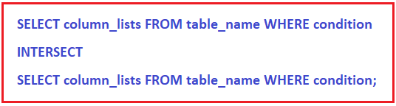
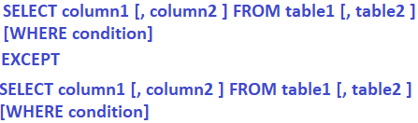
SQL Commands: Set Operations
MySQL EXCEPT Operator:
The EXCEPT operator is used to combine two tables or two result sets and will return rows from the first select statement that are not present in the second select statement.
But, the EXCEPT Operator is not supported by MYSQL. We can achieve the EXCEPT Operator functionality in MySQL using the following ways.
Using NOT IN Operator to achieve EXCEPT functionality:
Here, we are checking the FirstName column value only. Following is the SQL Query using the NOT IN Operator which returns the employees from the first EmployeeUK table that are not present in the EmployeeUSA table.
INTERSECT Operator in MySQL
The INTERSECT operator is used to combine two result sets and returns the data which are common in both the result set.
But the INTERSECT Operator is not supported by MYSQL. We can achieve the INTERSECT Operator functionality in MySQL using the following ways.
Using IN Operator to achieve INTERSECT functionality:
Here, we are checking the FirstName column value only. Following is the SQL Query using the IN Operator which returns the common employees i.e. the employees which are present in both t EmployeeUK and EmployeeUSA tables. Here, we are checking common based on the First Name column value.
SELECT * FROM EmployeeUK
WHERE FirstName IN (SELECT FirstName FROM EmployeeUSA);

Slide 43
Numerical Functions in SQL
ABS() Function
ABS() function is a mathematical function that returns the absolute(positive) value of a given numeric expression.
The ABS() function changes negative values to positive values. It has no effect on zero or positive values.
SELECT ABS(-7 + 5) AS Result;
CEILING() Function: Rounds Decimal Value
CEILING() function rounds the decimal number to the nearest integer number that is larger than or equal to the specified number.
select CEILING(12.2) as result; --13
FLOOR() Function
FLOOR() function returns the nearest integer that is less than or equal to the specified number or numeric expression.
The FLOOR() function is mainly used to round the floating-point value without fraction part from the floating point number value (decimal, double, float).
select floor(12.2) as result; --12

Slide 44
Date Functions in SQL
CURRENT_TIMESTAMP() Function
CURRENT_TIMESTAMP() function returns the current system timestamp.
SELECT CURRENT_TIMESTAMP AS CurrentServerDateTime;
DATE_ADD() Function
DATE_ADD() function adds a number to a datepart and returns the modified datetime value. The following example adds 1 day to the specified date
SELECT DATE_ADD('2022/10/01',interval 1 day) AS Result; -- 2022-10-02
DATEDIFF(expr1,expr2)
DATEDIFF() returns expr1 − expr2 expressed as a value in days from one date to the other. expr1 and expr2 are date or date-and-time expressions.
SELECT DATEDIFF('2022/10/01','2022/09/25’); --6

Slide 45
String Functions in SQL
ASCII(str): Returns the numeric value of the leftmost character of the string str. Returns 0 if str is the empty string. Returns NULL if str is NULL. ASCII() works for 8-bit characters.
SELECT ASCII('A’); --65
INSERT(str,pos,len,newstr) :Returns the string str, with the substring beginning at position pos and len characters long replaced by the string newstr.
SELECT INSERT('Quadratic', 3, 4, 'What’); ---QuWhattic
INSTR(str,substr) : Returns the position of the first occurrence of substring substr in string str.
SELECT INSTR('foobarbar', 'bar’); -- 4
select LCASE('CoLleGe’); ---- college
select Length('vit’); --3

Slide 46
Joins in SQL
What are JOINS in SQL?
The Joins in SQL are basically used to fetch the rows from two or more related tables.
The tables involved in the join are basically related to each other using the primary key and foreign key relationship but the important point is that it is not mandatory.
What it means, the tables involved in the MySQL Joins must have a common field. Common filed means both the column must be compatible in terms of data type and based on that common field the MySQL JOINS retrieves the data.
Why should we use JOINS?
With JOINS we can achieve better MySQL and application performances as it can use indexing.
Instead of using multiple queries JOIN simply uses a single query with any search parameters which gives us better performance as compared to subqueries.

Slide 47
Joins in SQL
Types of JOINS in MySQL
There are mainly 3 types of joins in MySQL:
INNER JOIN: The Inner join returns only the matching records from both the tables involved in the Join. Non-matching records are eliminated.
OUTER JOIN: The Outer Join retrieves the matching records as well as non-matching records from both the tables involved in the join in MySQL.
CROSS JOIN: If two or more tables are combined with each other without any condition then we call it cross join in MySQL. In cross join, each record of a table is joins with each record of another table.
We are going to use the following Employee and Projects tables to understand the Joins in MySQL. Here, the EmployeeId in the Projects table is the foreign key referencing the Id column of the Employee table which is the primary key in the Employee table.

Slide 48

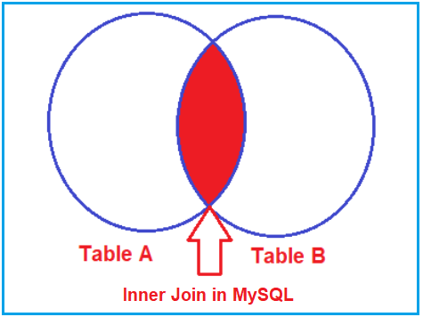
Joins in SQL
Inner Join in MySQL
An INNER JOIN in MySQL is created by using the INNER JOIN keyword.The Inner Join in MySQL is used to return only the matching rows from both the tables involved in the join by removing the non-matching records.
Note: The INNER JOIN returns the rows in the result set where the column value in a row of table1 is equal to the column value in a row of table2. In INNER JOIN the ON clause defines the columns and condition to be evaluated.
Inner Join Example :
We need to retrieve EmployeeId, Name, Department, City, Title as Project, and ClientId from the Employee and Projects tables.
If you look at the above output, we got only 8 rows. We did not get the 3 rows that have the NULL value in the EmployeeId column of the Projects table.

Slide 49
Joins in SQL
Outer Join in MySQL
Unlike INNER JOIN, the OUTER JOIN returns matched data rows as well as unmatched data rows from both the tables involved in the join. Outer join is again classified into three types.
Left outer join
Right outer join
Full outer join
Left Outer Join in MySQL
The LEFT OUTER JOIN in MySQL retrieves all the matching rows from both the tables as well as non-matching rows from the left side table.
In this case, the un-matching data will take a null value.
The most obvious question is which is the left table and which is the right table?
The answer is, the table mentioned to the left of the LEFT OUTER JOIN keyword is the left table, and the table mentioned to the right of the LEFT OUTER JOIN keyword is the right table

Slide 50
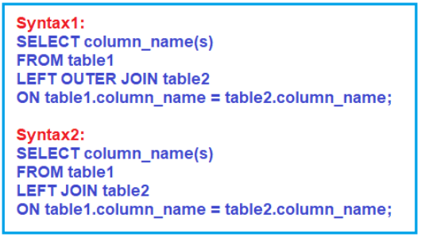
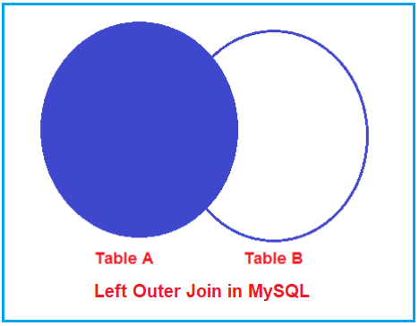
Joins in SQL
Left Outer Join in MySQL
In MySQL, you can use either the LEFT OUTER JOIN or LEFT JOIN keyword to perform Left Outer Join.
we need to write a query to retrieve EmployeeId, Name, Department, City, and Title as Project from the Employee and Projects tables.
If we look at the output, here, we got all 10 rows (i.e. all the rows from the Employee Table) including the row that has a null value for the EmployeeId column in the Projects table.
So, this proofs that the Left Outer Join will retrieve all the rows from the Left-hand side Table including the rows that have a null foreign key value in the right-hand side table.

Slide 51
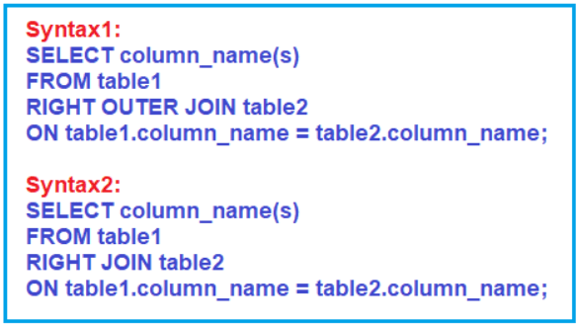
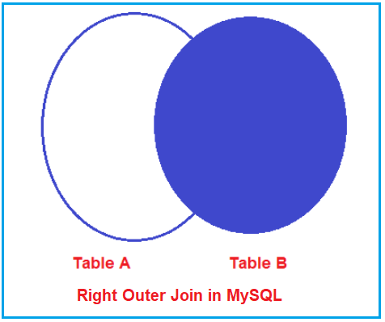
Joins in SQL
The RIGHT OUTER JOIN in MySQL retrieves all the matching rows from both the tables as well as non-matching rows from the right-side table.
In this case, the un-matching data will take a null value.
we need to write a query to retrieve EmployeeId, Name, Department, City, and Title as Project from the Employee and Projects tables.
Here, we got all 11 rows (i.e. all the rows from the Projects Table). If you further notice, here, we got all the matching records from both the tables Employee and Projects as well as all the non-matching rows from the right-side table i.e. the Projects Table.

Slide 52
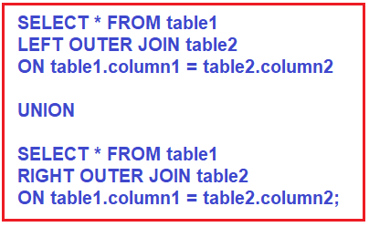
Joins in SQL
Full Outer Join in MySQL
The FULL OUTER JOIN retrieves all the matching rows from both the tables as well as non-matching rows from both the tables involved in the Join. In this case, the un-matching data will take a null value. MySQL doesn’t support FULL OUTER JOIN; we will achieve the FULL OUTER JOIN using UNION Operator in MySQL
Cross Join in MySQL
The CROSS JOIN is created by using the CROSS JOIN keyword. The CROSS JOIN does not contain an ON clause. Unlike INNER JOIN, the CROSS-JOIN returns matched data rows as well as unmatched data rows from the table.
When we combine two or more tables with each other without any condition (where or on) then we call such type of joins as cross join.
A Cross Join in MySQL produces the Cartesian product of the tables involved in the join. The Cartesian product means the number of records present in the first table is multiplied by the number of records present in the second table.
The Employee is the LEFT Table which contains 10 rows and Projects is the RIGHT Table which contains 11 rows. So, when you execute the above query, you will get 110 records in the result set.

Slide 53
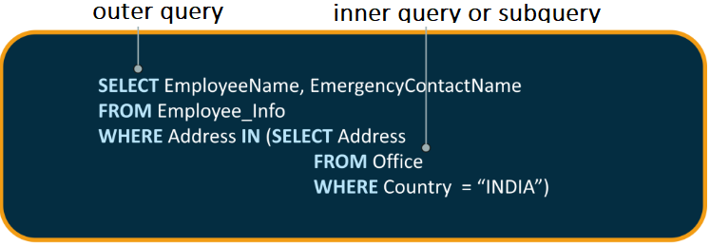
Nested queries in SQL
Nested queries are those queries which have an outer query and inner subquery.
So, basically, the subquery is a query which is nested within another query such as SELECT, INSERT, UPDATE or DELETE.
SQL subqueries or nested queries are SQL statements where we need the results from our database after using multiple filters.
SELECT column_name
FROM table_name1
WHERE VALUE IN
(SELECT column_name
FROM table_name2
WHERE condition)

Slide 54
Nested queries in SQL
Rules to Use Subqueries in SQL
Subqueries need to be enclosed in the Where clause and can be used with Insert, Update, Delete, and Select statements.
We can use comparison operators for example: <, >, > =, < =, !=, IN , Between for the subqueries.
The subquery is always executed first and then the main query.
Subquery should be enclosed within parentheses.
Subqueries are always to the right of the comparison operators.
We can’t use Order By clause in the subquery; instead, we can use the Group By clause.
We can’t use Between clause with a subquery, but we can use Between in a subquery.

Slide 55
Nested queries in SQL
Update Statement with Subquery
Example 2: Let us increase the salary of Senior Manager to 35000.
UPDATE EMP AS E, (SELECT EmployeeID FROM emp WHERE post='Sr.Manager') AS P
SET E.salary=35000
WHERE E.EmployeeID = P.EmployeeID;
SELECT Statement with Subquery
Example 1: Let us find the second highest salary of the employee in emp
SELECT emp_id, MAX(salary) AS salary
FROM emp
WHERE salary < (SELECT MAX(salary)
FROM emp);

Slide 56
Data Control Language
DCL commands are used to grant and take back authority from any database user.
Here are some commands that come under DCL:
Grant
Revoke
Grant: It is used to give user access privileges to a database.
Example GRANT SELECT, UPDATE ON MY_TABLE TO SOME_USER, ANOTHER_USER;
Revoke: It is used to take back permissions from the user.
Example REVOKE SELECT, UPDATE ON MY_TABLE FROM USER1, USER2;

Slide 57
Transaction Control Language
TCL commands can only use with DML commands like INSERT, DELETE and UPDATE only.
Here are some commands that come under TCL:
COMMIT
ROLLBACK
SAVEPOINT
Commit: Commit command is used to save all the transactions to the database.
Syntax: COMMIT;
DELETE FROM CUSTOMERS
WHERE AGE = 25;
COMMIT;

Slide 58
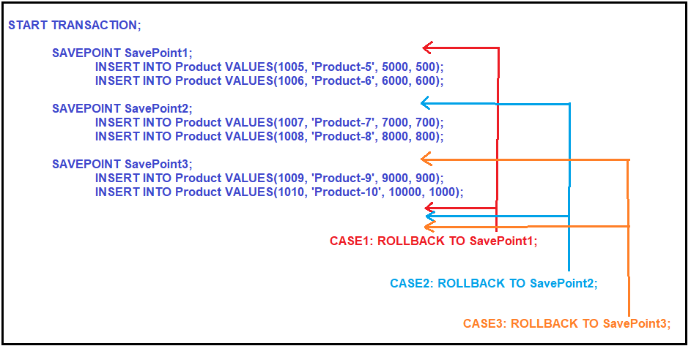
Transaction Control Language
ROLLBACK TO SavePoint2;
Once you execute the above rollback statement, then commit the transaction by executing the below commit statement which will commit two records (ProductId 1005 and 1006) into the database.
COMMIT;

Slide 59
Transaction Control Language
Rollback: Rollback command is used to undo transactions that have not already been saved to the database.
Syntax: ROLLBACK;
DELETE FROM CUSTOMERS
WHERE AGE = 25;
ROLLBACK;
SAVEPOINT: It is used to roll the transaction back to a certain point without rolling back the entire transaction.
SAVEPOINT SAVEPOINT_NAME;

Slide 60
SQL Stored Procedures
A procedure (often called a stored procedure) is a collection of pre-compiled SQL statements stored inside the database.
It is a subroutine or a subprogram in the regular computing language. A procedure always contains a name, parameter lists, and SQL statements.
It is collection of MySQL statements grouped together in a function that can be called on-demand with specific input parameters.
With these, you get to reuse the code and Lesser Network transfer – E.g. for web applications -instead of calling individual queries, a procedure that can directly return the desired result can be executed.
More secure – The Database Administrator can GRANT or REVOKE privileges at a procedure level.

Slide 61
SQL Stored Procedures
Delimiter //
CREATE PROCEDURE procedure name(parameters)
BEGIN
statements;
END //
Delimiter;
In MySQL, we use a semicolon (;) as a default delimiter to separate the statements and execute them separately.
The name of the procedure must be specified after the Create Procedure keyword
After the name of the procedure, the list of parameters must be specified in the parenthesis. The parameter list must be comma-separated
The SQL Queries and code must be written between BEGIN and END keywords
Delimiters are used when we need to define the stored procedures as well as to create triggers.

Slide 62
Why Do We Need Delimiter?
When you write an individual statement you will need only a semicolon at the end of the statement.
But what if you want to write a block of statements that works as a single unit? In that case, you will need to change the delimiter.
In MySQL, stored procedures, functions and triggers are the blocks of statements where you need the delimiter other than the default semicolon. The delimiter helps MySQL to acknowledge the group of statements as a single unit or single task. However, the individual statements in the blocks end with semicolons.
If you are considering multiple statements, then you need to use different delimiters like $$ or //.
How To Change the Delimiter?
You can change the delimiter by using the DELIMITER keyword.
DELIMITER delimiter_character;
The delimiter_character must be an unreserved character in MySQL for example, // , $$, ## etc.

Slide 63
Create Procedure Example
use company;
DELIMITER //
CREATE PROCEDURE viewEmployees()
BEGIN
SELECT * FROM Employee;
END //
DELIMITER ;
mysql> CALL viewEmployees();

Slide 64
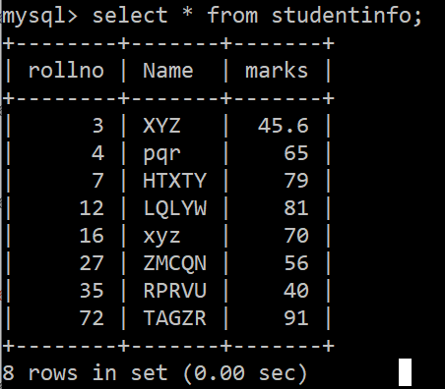
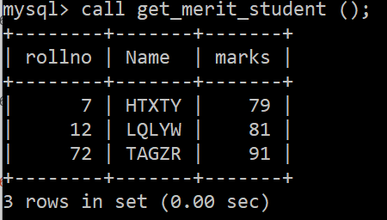
Create Procedure Example
Display all records of studentinfo table whose marks are greater than 70
DELIMITER &&
CREATE PROCEDURE get_merit_student ()
BEGIN
SELECT * FROM studentinfo WHERE marks > 70;
END &&
DELIMITER ;

Slide 65
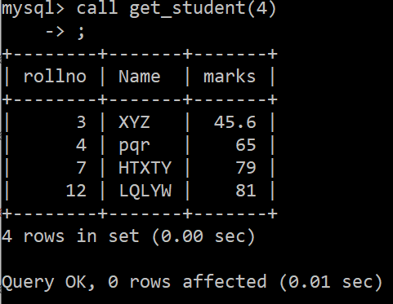
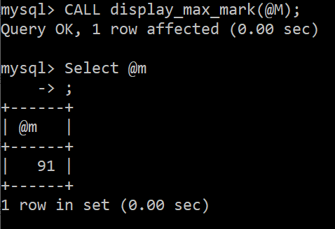
Create Procedure Example
Procedures with Parameter
DELIMITER &&
CREATE PROCEDURE get_student (IN var1 INT)
BEGIN
SELECT * FROM studentinfo LIMIT var1;
END &&
DELIMITER ;
DELIMITER &&
CREATE PROCEDURE display_max_mark (OUT highestmark INT)
BEGIN
SELECT MAX(marks) INTO highestmark FROM studentinfo;
END &&
DELIMITER ;
@M is Session vaiable

Slide 66
SQL Function
A function in MySQL is a subprogram that is used to perform an action such as complex calculations and returns the result of the action as a value. There are two types of functions available in MySQL. They as follows:
System Defined Function
User-Defined Function
The functions which are already defined or predefined by MySQL and ready to be used by the developer are called as system-defined function whereas if the function is defined by the developer, then such functions are called as a user-defined function.
Some functions take parameters; do some processing and returning some results back. For example, SELECT SQRT(16); will return the square root of 16 i.e. 4.
Some functions do not take any parameters but return some results back. For example, SELECT NOW(); will return the current date-time like 2021-07-09 07:11:07.

Slide 67
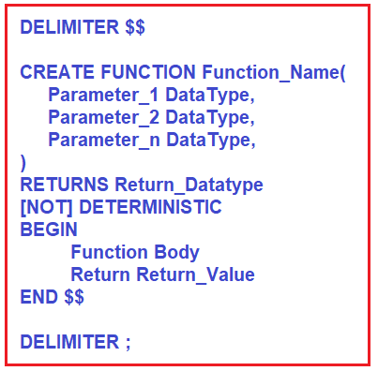
SQL Function
How to Create User-Defined Functions
First, we need to specify the name of the user-defined function
Second, list all the input parameters of the user-defined function
Third, specify the data type of the return value in the RETURNS statement.
Fourth, specify if the function is deterministic or not
If we don’t specify MySQL uses the NOT DETERMINISTIC option. A deterministic function in MySQL always returns the same result for the same input parameters whereas a non-deterministic function returns different results for the same input parameters.
Fifth, write the code in the body of the user-defined function within the BEGIN & END block.

Slide 68
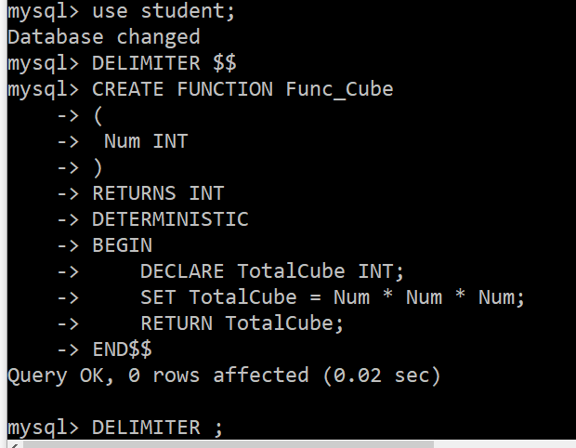
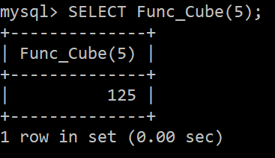
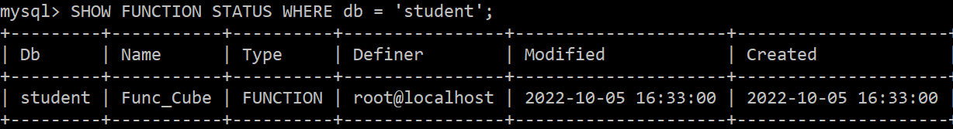
SQL Function
Create a Function in MySQL which should return the cube of a given value.
How to Call a User Defined Function in MySQL?

Slide 69
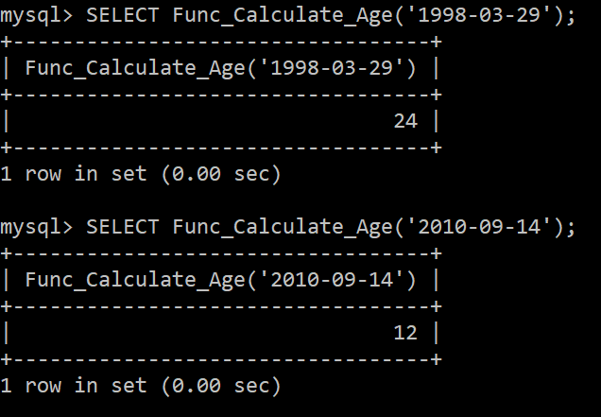
SQL Function
DELIMITER $$
CREATE FUNCTION Func_Calculate_Age
(
Age date
)
RETURNS INT DETERMINISTIC
BEGIN
DECLARE TodayDate DATE;
SELECT CURRENT_DATE() INTO TodayDate;
RETURN YEAR(TodayDate) - YEAR(Age);
END$$
DELIMITER ;
Create a User-defined Function in MySQL to calculate the age.
Let us create a user-defined stored function that will calculate and returns the age of an employee. To compute the age, we require the date of birth.

Slide 70
Functions Vs Stored Procedures
Function | Stored Procedure
Always returns a single value; either scalar or a table. | Can return zero, single or multiple values.
Functions are compiled and executed at run time. | Stored procedures are stored in parsed and compiled state in the database.
Only Select statements. DML statements like update & insert are not allowed. | Can perform any operation on database objects including select and DML statements.
Allows only input parameters. Does not allow output parameters. | Allows both input and output parameters
Does not allow the use of Try…Catch blocks for exception handling. | Allows use of Try…Catch blocks for exception handling.
Cannot have transactions within a function. | Can have transactions within a stored procedure.
Cannot call a stored procedure from a function. | Can call a function from a stored procedure.
Functions can be called from a Select statement. | Stored procedures cannot be called from a Select/Where or Having statements. Execute statement has to be used to execute a stored procedure.
Functions can be used in JOIN clauses. | Stored procedures cannot be used in JOIN clauses

Slide 71
Triggers in SQL
Triggers are a set of SQL statements which are stored in the database catalog. These statements are executed whenever an event associated with a table occurs.
So, a trigger can be invoked either BEFORE or AFTER the data is changed by INSERT, UPDATE or DELETE statement.
Before Insert: It is activated before the insertion of data into the table.
After Insert: It is activated after the insertion of data into the table.
Before Update: It is activated before the update of data in the table.
After Update: It is activated after the update of the data in the table.
Before Delete: It is activated before the data is removed from the table.
After Delete: It is activated after the deletion of data from the table.

Slide 72
Triggers in SQL
Use Student;
CREATE TABLE employee(
name varchar(45) NOT NULL,
occupation varchar(35) NOT NULL, working_date date,
working_hours varchar(10)
);
Syntax:
CREATE TRIGGER trigger_name
(AFTER | BEFORE) (INSERT | UPDATE | DELETE)
ON table_name FOR EACH ROW
BEGIN
--variable declarations
--trigger code
END;
INSERT INTO employee VALUES ('Robin', 'Scientist', '2020-10-04', 12),
('Warner', 'Engineer', '2020-10-04', 10), ('Peter', 'Actor', '2020-10-04', 13),
('Marco', 'Doctor', '2020-10-04', 14),('Brayden', 'Teacher', '2020-10-04', 12),
('Antonio', 'Business', '2020-10-04', 11);

Slide 73
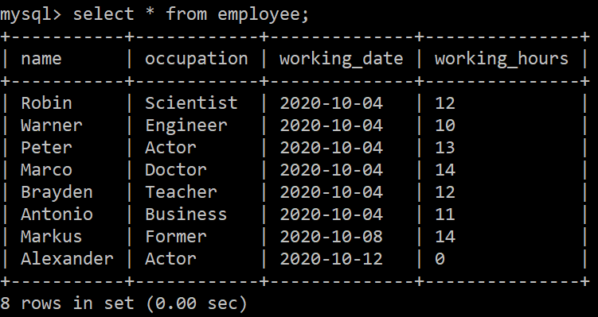
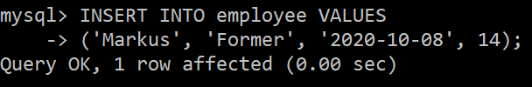
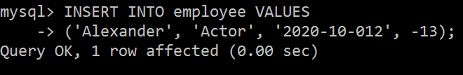
Triggers in SQL
we will create a BEFORE INSERT trigger. This trigger is invoked automatically insert the working_hours = 0 if someone tries to insert working_hours < 0.
DELIMITER //
Create Trigger before_insert_empworkinghours
BEFORE INSERT ON employee FOR EACH ROW
BEGIN
IF NEW.working_hours < 0 THEN SET NEW.working_hours = 0;
END IF;
END //
DELIMITER ;

Slide 74
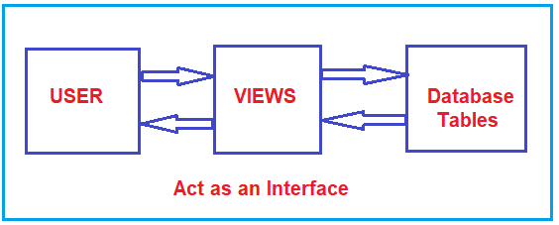
Views in SQL
VIEW is a database object that can be created like a table. In SQL, a VIEW is similar to a virtual table. But unlike tables VIEWS don’t actually store data.
For security purposes, we can restrict users from accessing underlying tables and instead give access to views or virtual tables with limited columns.
Since, every time user request view, the database engine recreates the result set, which always returns up-to-date data rows from views.

Slide 75
Views in SQL
Table Vs View
The table is physical i.e. it is an actual table whereas the view is logical i.e. it is a virtual table.
A Table is an independent object whereas a view is a dependent object.
The Table stores the actual data of the database whereas View creates a logical subset of data from one or more tables.
When a new table is created from an existing table, the new and old tables are independent themselves, that is the changes of one table will not be reflected into the other table whereas if a view is created based on a table, any changes that are performed on the table will reflect into the view and any changes performed on the view reflected in the table also.

Slide 76
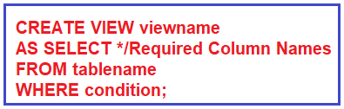
Views in SQL
Use Student;
-- Create Employee Table
CREATE TABLE Employee1
(
Id INT PRIMARY KEY,
Name VARCHAR(50),
GenderId VARCHAR(50),
Salary INT,
Department VARCHAR(50)
);
-- Populate the Employee Table with test data
INSERT INTO Employee VALUES(1, 'Pranaya', 1, 20000, 'IT');
INSERT INTO Employee VALUES(2, 'Priyanka', 2, 30000, 'HR');
INSERT INTO Employee VALUES(3, 'Anurag', 1, 40000, 'IT');
INSERT INTO Employee VALUES(4, 'Preety', 2, 25000, 'HR');
INSERT INTO Employee VALUES(5, 'Sambit', 3, 35000, 'INFRA');
INSERT INTO Employee VALUES(6, 'Hina', 2, 45000, 'HR');
How to Create a View in MySQL?
CREATE VIEW vwEmployee AS SELECT * FROM Employee;

Slide 77
Data Query Language
DQL is used to fetch the data from the database.
It uses only one command:
SELECT
SELECT: This is the same as the projection operation of relational algebra. It is used to select the attribute based on the condition described by WHERE clause.
Syntax: SELECT expressions SELECT emp_name
FROM TABLES FROM employee
WHERE conditions; WHERE age > 20;

